Slide 1
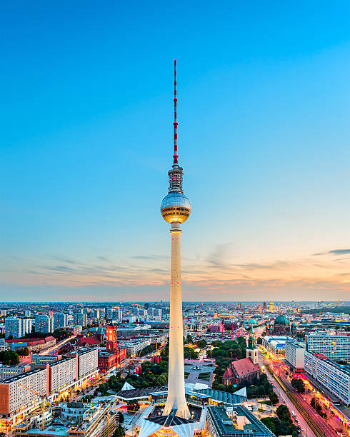
Life in Berlin
Results from a small survey about life in Berlin

Slide 2
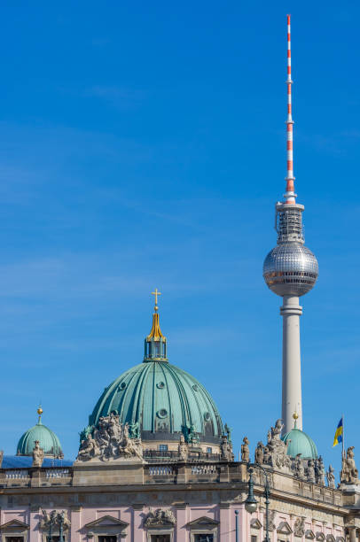


Intro
Why did we choose this topic?
How many people answered the survey?

Slide 3
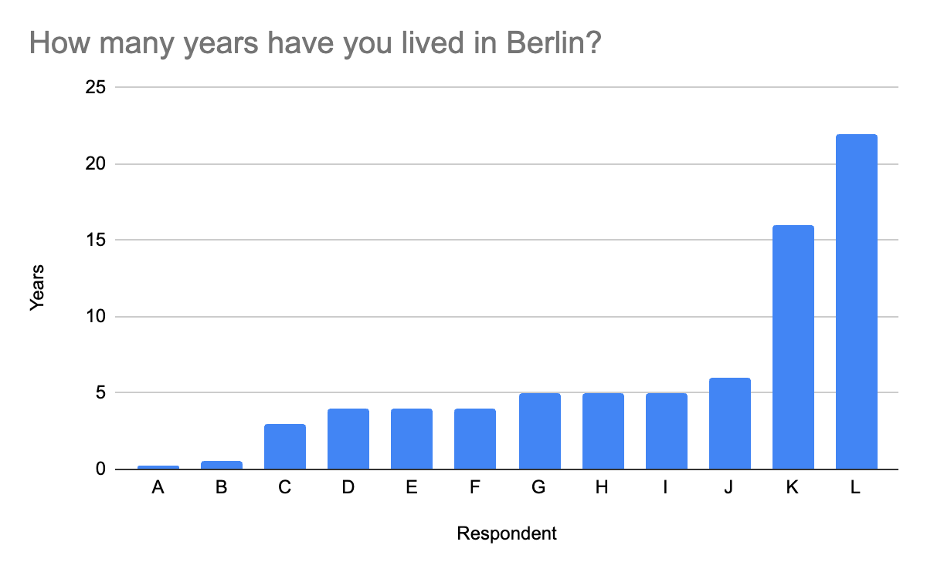
Question 1: How many years have you lived in Berlin?
Average: 6.2 years
75% of the group are 5 years or less
Newest Berliner: 3 months
Veteran Berliner: 22 years

Slide 4
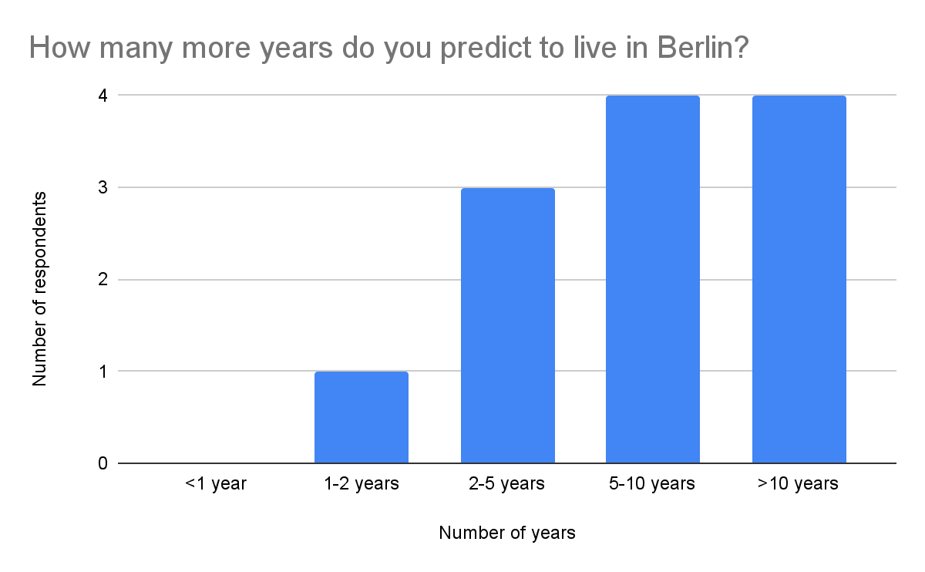
Question 2: How many more years do you predict to live in Berlin?
All respondents plan to live in Berlin for at least one year
Most people (66% - 2 out of 3) see themselves living in Berlin at least 5 more years.
Only one person will live in Berlin for 1-2 years.

Slide 5
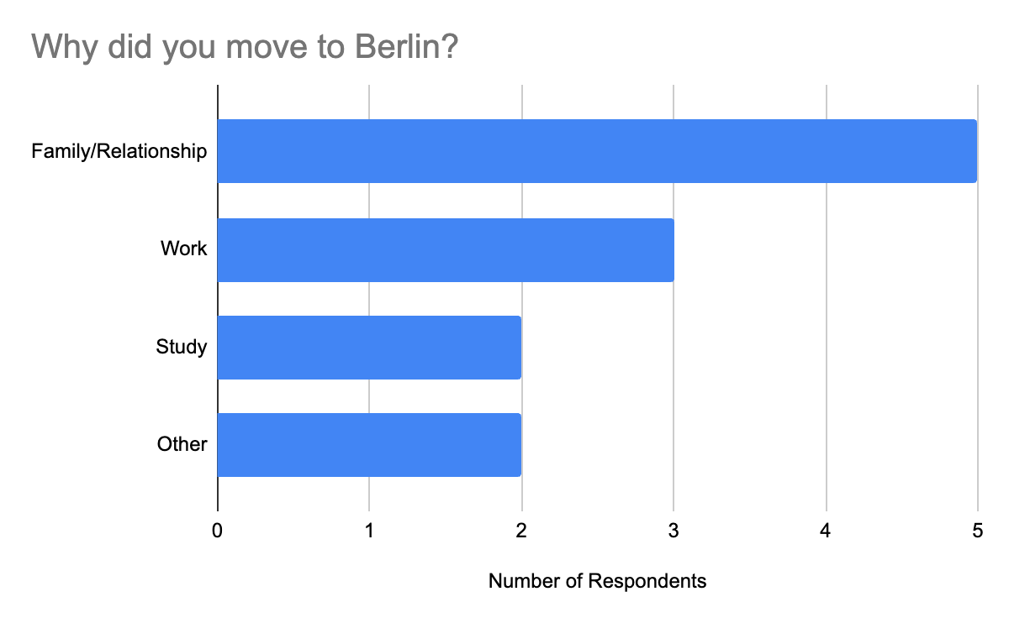
Question 3: Why did you move to Berlin?
Almost half (42%) of respondents moved to Berlin for family/relationships
Other common reason is work (25% of respondents).

Slide 6
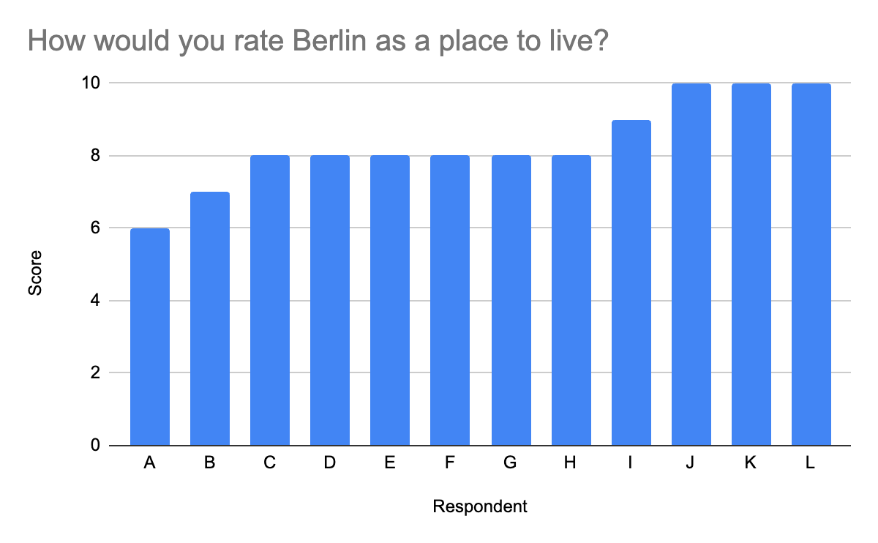
Question 4: How would you rate Berlin as a place to live?
Average: 8.3
Most common response: 8
Only 25% gave Berlin a perfect 10

